Slide 1
Career Interest and Technology
Name
Institution
Date

Slide 2

Career Pursuit
A Cyber Security;
Establishes security for data
Inspects hardware and software
Monitors data attacks and intrusions
Notes:
The work of the Cyber Security officer is to establish and provide security in the development phase of software systems, networks, and data centers. The cyber Security officers also look for vulnerabilities and risks in hardware and software and inform the management and find the best way to protect their IT infrastructure. They also continuously monitor attacks and intrusions, and when they discover any potential threats, they close the security loopholes.

Slide 3
Primary technology in three years
Hardware authentication which will;
Provide a solution to hardware insecurities
Use multiple authentications
Apply chipset technology
Notes:
Recently there have been security shortcomings in the application of usernames and passwords. Therefore need for a more secure form of authentication is needed. Experts have come up with a way that involves integrating authentication into the user's hardware. This is an advanced technology aimed at providing the solution to authentication insecurities in hardware devices (Husain, Khan & Tyagi, 2020). This technology will allow a combination of multiple hardware enhancement factors at the same time to verify user identity. The technology is being developed to enable the use of part of the chipset to enhance security features hence making the device part of the authentication process. Hardware authentication will ensure that anybody trying to access the hardware devices is first verified for access.

Slide 4
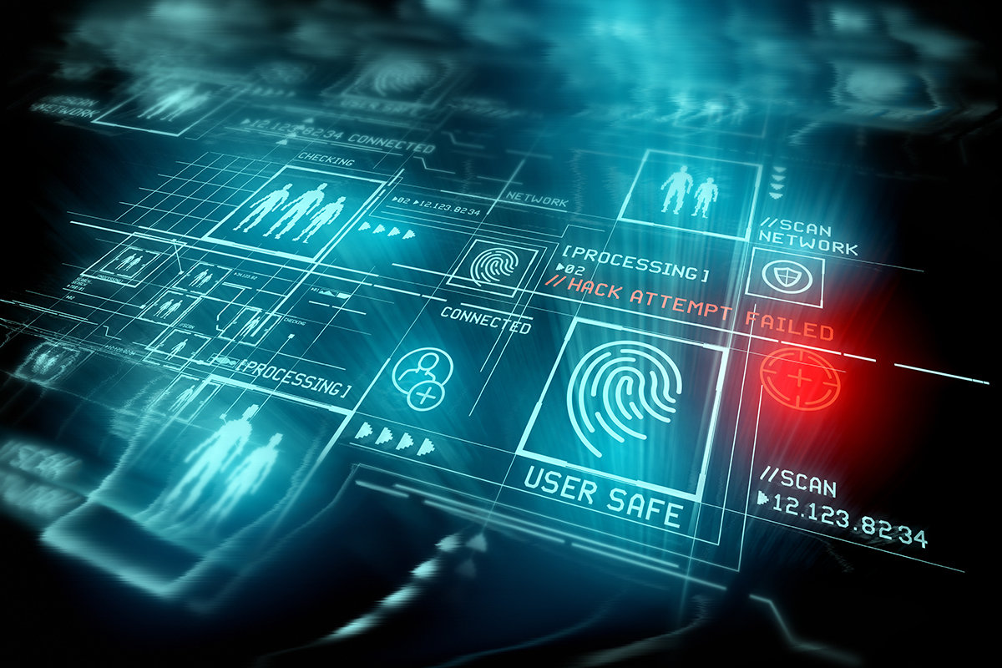
Continuation…
Combine different identifiers
Be based on multimodal biometric recognition
Involve silent authentication
Notes:
For security purposes, much is expected to change. Many organizations will move towards the use of multimodal biometric recognition, which combines identifiers such as fingerprints, voice, facial recognition, iris pattern, and gait analysis to generate high-reliability biometric matches. Through the combination of the biometric factors, the hardware systems will be able to produce a perfect biometric match, which will be more reliable than the present one, which uses a single factor for identification. Also use of silent authentication will become more popular, making it unnecessary for users to use biometric identifiers. There will be no need for the hardware systems to be fed with biometric data; instead, they will continuously and automatically capture many biometric factors based on the needs of the system being accessed.

Slide 5
Other Technologies in Ten Years
User-behavior analytics aimed at;
Providing security for organizations’ data
Addressing employee negligence
Using of phishing stimulation
Notes:
This is a modern technology that is used in large organizations with big data to identify abnormal user behavior. This technology works efficiently in providing security for the organization's data, and it is even expected to advance its scope of usage in the coming years (Akutota & Choudhury, 2017). It will not only identify and track malicious activities by the users of the organization's devices, but it will be able to track and address human negligence by the employees directly. The UBA is expected to apply phishing simulation as part of an information security measure to address the employers' efficiency. The system will be able to identify employees who put the organization at risk of losing data by pressing phishing attempts. This will enhance timely warning and education on the employees and improve the organization's capacity to keep data secure.

Slide 6
Continuation…
Use of cloud computing aimed at;
Improving intelligence in cyber security operations
Improving security of systems
Efficient ways of using cloud
Notes:
Clouding computing is a new trend that is expected to dominate all the fields that require intelligence operations. I can foresee that this trend will have dominated the cyber security sector in ten years, especially as the industry-wide adoption rate continues to rise. It is expected that the use of clouding technology, such as video and access control systems, will grow substantially over the years (Senyo, Addae & Boateng, 2018). Large organizations are experiencing the benefits of cloud computing as part of their security strategy as it has enhanced remote capabilities and automatic software updates. Overall, the use of clouding technology is expected to transform the security technology industry positively. Apart from the use of traditional use of cloud in IT, more secure ways of using cloud are going to emerge. Some of the methods will involve application in virtualized firewalls, hardware, and defense and intrusion detection systems.

Slide 7
Continuation…
Quantum computing which will;
Use advanced computing models
Use more advanced qubit drives
Advance artificial intelligence
Replace current security encryptions
Video https://www.youtube.com/watch?v=WVv5OAR4Nik
Notes:
Quantum computer technology involves the use of a new computing model based on qubits drives instead of the normal bits. The qubits are more flexible as they can be opened, closed, and replaced. They are always physically attached to each other. The qubits' unique characteristics allow quantum computers to perform their duties faster and efficiently than normal computers (Das et al., 2018). These computers also help in the advancement of artificial intelligence, the development of new materials, and find ways to treat a certain disease. Scientists have made significant progress in the development of Quantum computing to an extent where they projected in some years; there will be developed quantum application stores and codes. The use of quantum computing is expected to make current practices of encryption obsolete. Also, the security certificates for emails, websites, and digital signatures used to verify authentication will be outdated.

Slide 8
Most Useful Social Media
Use of Twitter since;
It provides real-time information
It gives detailed information
It provides fine details
Notes:
Twitter is becoming a very reliable social media platform in real-time delivery and acquisition of information, and therefore Super Security cyber security officers make use of reliable real-time information in executing their duties. Thanks to Twitter, getting real-time information is slowly being achieved as it is becoming more convenient. It is approximated that around 5000 tweets are sent every second on Twitter. Through the use of Twitter, Cyber security officers can integrate and relate more information about suspected cyber attacks. Most of the news shared on Twitter is reliable as they are usually the latest or the expected occurrence. Therefore security personnel can get finer details by analyzing suspected hacking cases and other cybercrimes shared through various hashtags (Martinez-Rojas et al., 2018).

Slide 9
Continuation…
It encourages vulnerability monitoring
It ensures the speedy distribution of information
It enables account visibility and verification
Notes:
The speed at which information is shared through a Twitter platform is very viable as it helps Cyber security officers to monitor whether common vulnerabilities are fully exploited. The information provides awareness to the Cyber security officers and, therefore, measures to protect the organization's computer systems and data. The use of Twitter will enable the officers to react very fast to any systems and data risks and ensure that the most critical assets and sensitive data are safe from any trending cyber-attack threats. The cyber security team can also use Twitter visibility to assess whether their data and computer assets are exposed to attacks. Twitter-based threat monitoring programs can target these accounts because they provide news and information on relevant security concerns. The security officers of an organization can also verify the Twitter accounts of suspected hackers through the use of social media bots.

Slide 10
Preparation for the technology revolution through;
Using technology-based course material
Undergoing specialized training
Training on projected technology techniques
Notes:
Technology is the biggest catalyst for change, not only in the security industry but also in other sectors. Therefore, I will ensure that I go through all the relevant technology materials in the school library to understand different authors' different technology projections. Since the future of the cyber security will rely on the ability to monitor and identify security loopholes and come up with necessary security measures in advance, I will train on general observations and analysis techniques. For quality services, after my current course will take a short course to specialize in a specific work environment so as to be able to tackle future technologies effectively and bring more value to the organizations and agencies that I will be working for.

Slide 11
Continuation…
Being innovative and technology-oriented
Use of computer programs to familiarize
Preparing for technology challenges
Notes:
Since I expect to apply my knowledge in the future, I will focus on discovering new gaps in the current technologies. I will try to apply technology to solve all the problems I encounter in my career, consequently helping me adopt new technologies in the future without any difficulties. Through this, I will also be preparing for possible challenges in the implementation of future new technologies. I will use all the available application programs to since most of the future technology developments are expected to be improvements of the current technologies. Practically applying the current software programs will help me project on the possible developments. This is very important since most of the content in the course material focuses on the theoretical part of the career. Practically familiarizing with the computer hardware and software makes the learning process easy and fun.

Slide 12
References
Akutota, T., & Choudhury, S. (2017). Big data security challenges: An overview and application of user behavior analytics. International Research Journal of Engineering and Technology, 4(10), 5.
Das, R., Yoder, J., Rosenberg, D., Kim, D., Yost, D. R., Mallek, J., ... & Oliver, W. (2018, May). Cryogenic qubit integration for quantum computing. In 2018 IEEE 68th Electronic Components and Technology Conference (ECTC) (pp. 504-514). IEEE.
https://depositphotos.com/stock-photos/cybersecurity.html
https://www.csoonline.com/article/3339565/what-is-biometrics-and-why-collecting-biometric-data-is-risky.html
https://www.youtube.com/watch?v=WVv5OAR4Nik
Husain, R., Khan, R., & Tyagi, R. K. (2020). SECURITY ANALYSIS OF VARIOUS HASH ALGORITHMS FOR AUTHENTICATION UNDER HARDWARE CONSTRAINED ENVIRONMENT. International Journal of Engineering Technologies and Management Research, 7(6), 131-140.
Martinez-Rojas, M., del Carmen Pardo-Ferreira, M., & Rubio-Romero, J. C. (2018). Twitter as a tool for the management and analysis of emergency situations: A systematic literature review. International Journal of Information Management, 43, 196-208.
Senyo, P. K., Addae, E., & Boateng, R. (2018). Cloud computing research: A review of research themes, frameworks, methods and future research directions. International Journal of Information Management, 38(1), 128-139

